Slide 1

MINI PROJECT
Department of Computer Engineering & Application
Institute of Engineering & Technology
PROJECT: TRAVEL ADVISOR
GLA University
Mathura - 281406

Slide 2
Our Team Member are:
Name University Roll No.
Amit Kumar Yadav 201500081
Ashish Kumar 201500163

Slide 3
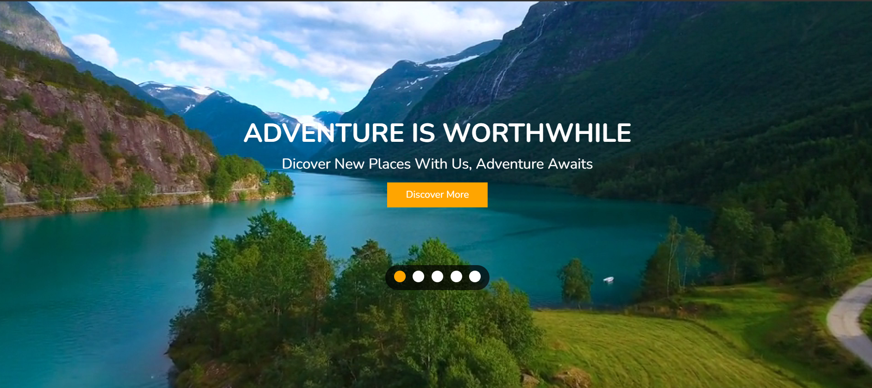
TRAVEL ADVISOR

Slide 4

INTRODUCTION
Travelling is an amazing way to learn a lot of things in life. A lot of people around the world travel every year to many places. Moreover, it is important to travel to humans. Some travel to learn more while some travel to take a break from their life. No matter the reason, travelling opens a big door for us to explore the world beyond our imagination and indulge in many things.
All in all, it is no less than a blessing to be able to travel. Many people are not privileged enough to do that. Those who do get the chance, it brings excitement in their lives and teaches them new things. No matter how a travelling experience may go, whether good or bad, it will definitely help you learn.

Slide 5
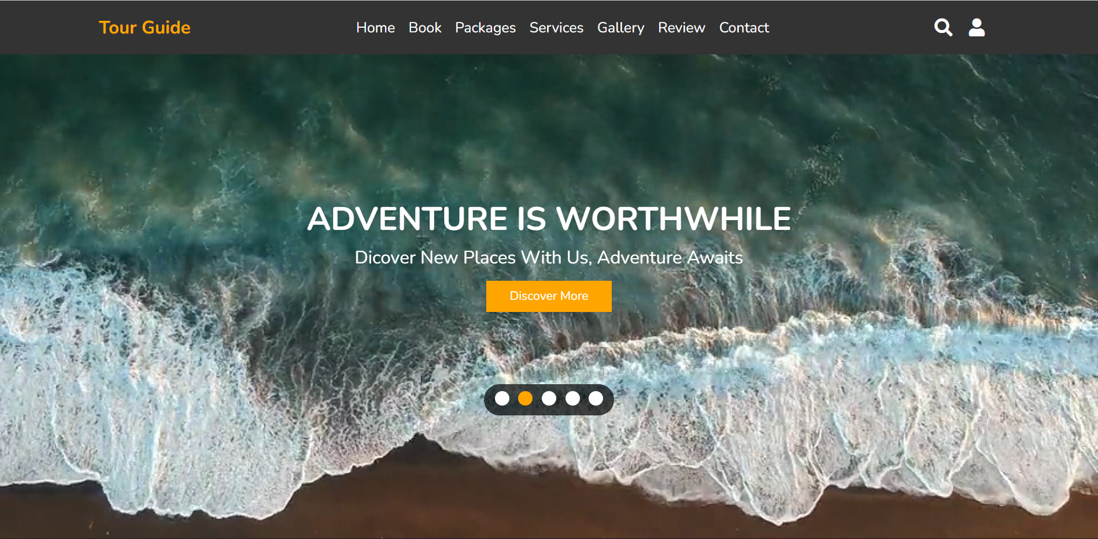
HOME PAGE
Online Travel Advisor is a user friendly project. In this project user can easily understand and book all packages. In this project there are various types of forms, like many destinations and their packages which customer can book with their own choices.
This site provides different tour packages and have many special tour packages. Through this site user can choose different types of packages and can send their details to us.
Online Travel Advisor is a Website made by Html, CSS and JavaScript, So With the help of this project user can apply for packages for their favorite
Destination for tour

Slide 6
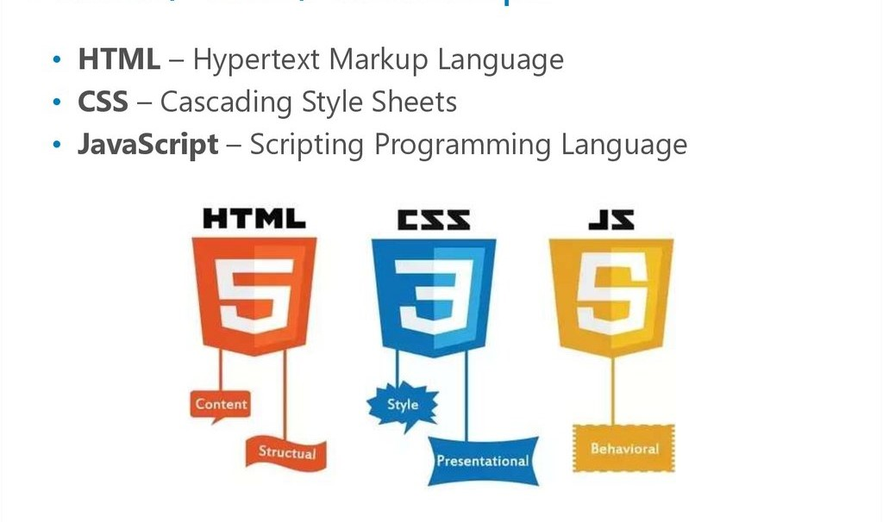
Technologies that are used to develop a website are:
HTML
CSS
JavaScript

Slide 7
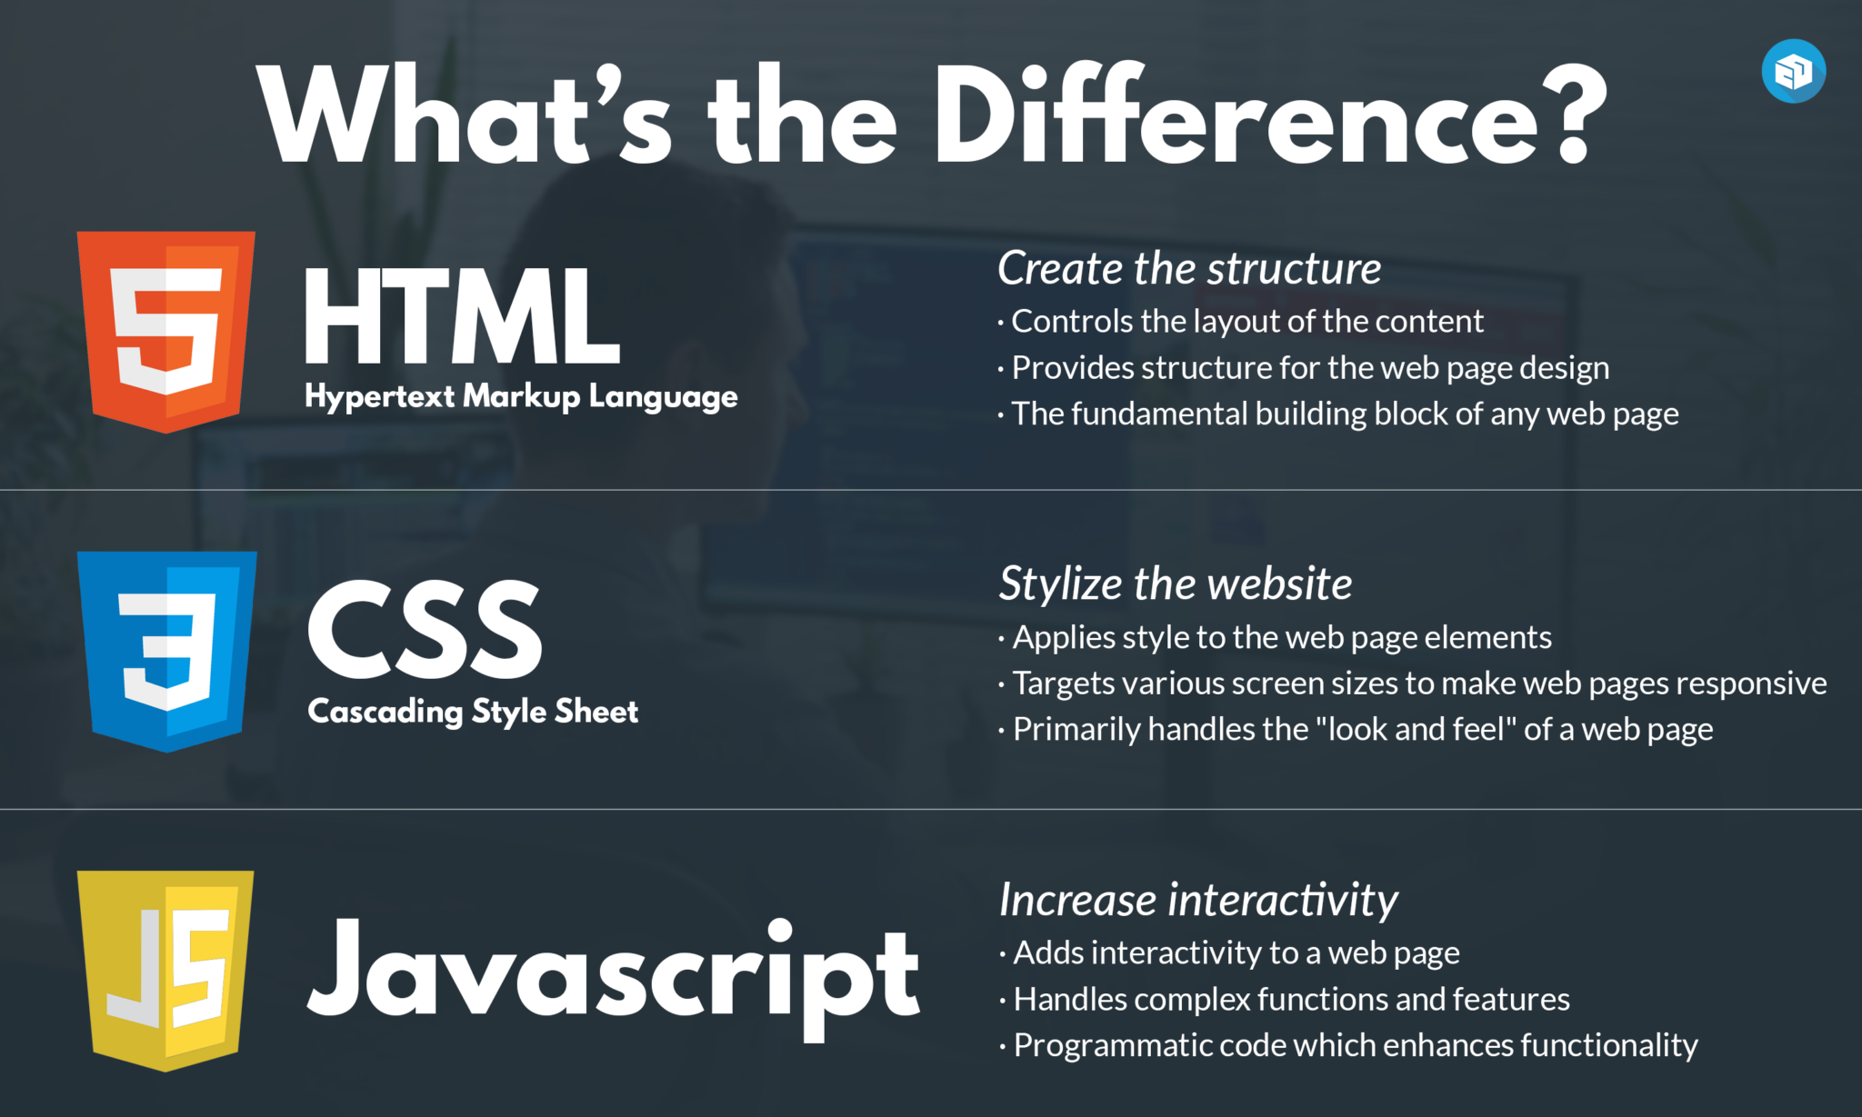

Slide 8
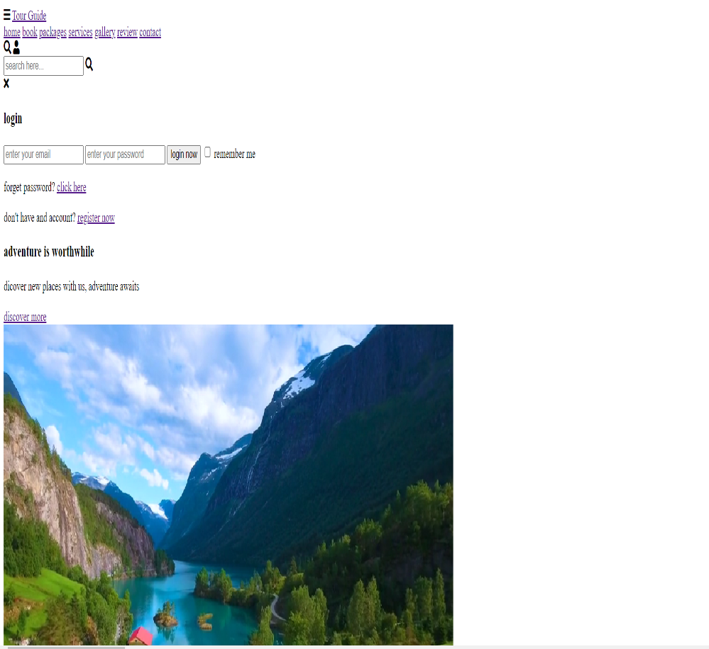
Using HTML in page:
HTML describes the structure of a web page semantically and originally included cues for the appearance of the document.
HTML elements are the building blocks of HTML pages. With HTML constructs, images and other objects, such as interactive forms, may be embedded into the rendered page. It provides a means to create structured documents by denoting structural semantics for text such as headings, paragraphs, lists, links, quotes and other items.

Slide 9
After using CSS in HTML page:
CSS Cascading Style Sheets (CSS) is a style sheet language used for describing the presentation of a document written in a markup language.
CSS is designed primarily to enable the separation of presentation and content, including aspects such as the layout, colors, and fonts .
This separation can improve content accessibility, provide more flexibility and control in the specification of presentation characteristics, enable multiple HTML pages to share formatting by specifying the relevant CSS in a separate .css file, and reduce complexity and repetition in the structural content.

Slide 10
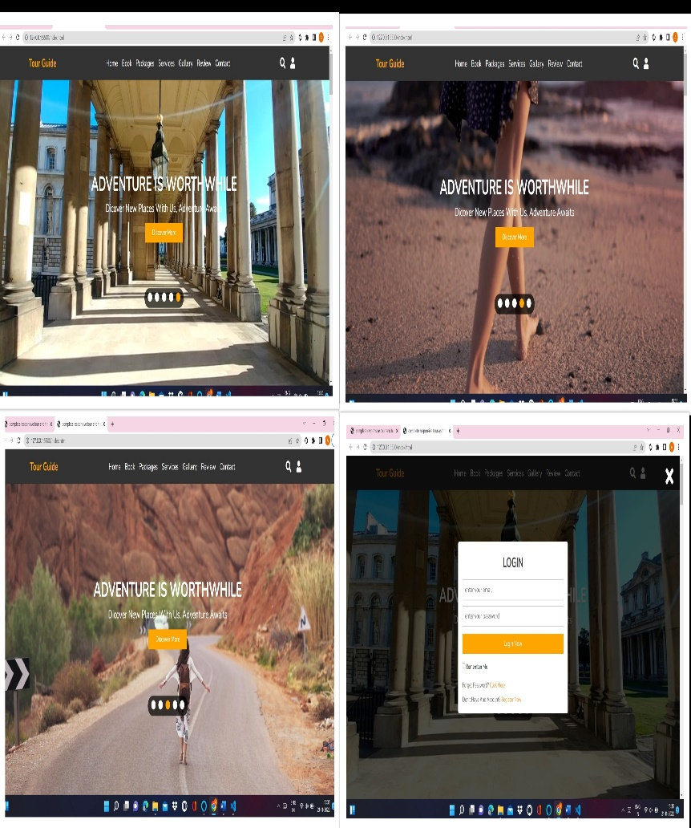
Use of JavaScript in Web page
JavaScript allows users to interact with web pages. There are almost no limits to the things you can do with JavaScript on a web page – these are just a few examples:
Show or hide more information with the click of a button
Change the color of a button when the mouse hovers over it
Slide through a carousel of images on the homepage
Zooming in or zooming out on an image
Displaying a timer or count-down on a website
Playing audio and video in a web page
Displaying animations
Using a drop-down hamburger menu

Slide 11
CONCLUSION
Outcomes
Able to use the HTML programming language. To Resolves written HTML codes.
To Runs the page designed using HTML codes.
Be able to use CSS for styling the web pages.
Able to modify Site Designs to look how we Want Them to Look.
Discover how does web works really, what makes web sites work.
Able to use Simple and impressive design techniques, from basics till advanced to focus on goal oriented and user centric designs.
Able to plan for website & actually build excellent web sites.
Pro level skills in SEO with keyword research and content strategy for our website.
Able to create web elements like buttons, banners & Bars and of course complete UI designs.
Ale to create Forms and validations for our website.
Setting up page layout, colour schemes, contract, typography in the designs ❖ Writing valid and concise code for webpages.
Best use of social media for revenue generation.
Setting up a perfect landing page for business, clients and yourself.
Publishes the site designed
Be able to make changes on the Site

Slide 12
OBJECTIVE:
“Travel Advisor” is the online website where users can find their favourite destinations to travel with their friends and family, in this project we tried to describe the famous places to visit in India and their best packages.
How to view website or code:
Website: https://amit-2526.github.io/Mini-Project/
Code: https://github.com/AshishKumar2002/Mini-Project

Slide 13
WEB PAGE DETAILS
Home Page
Services
Signup Page (to provide us details)
Travel Tips
About us

Slide 14
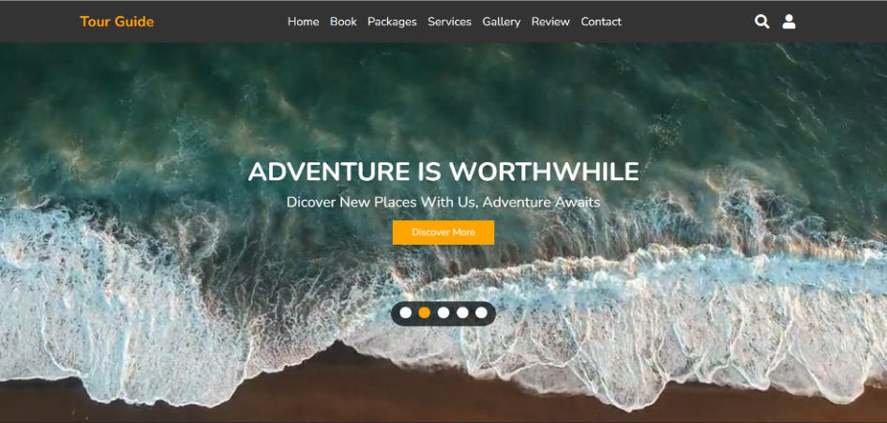
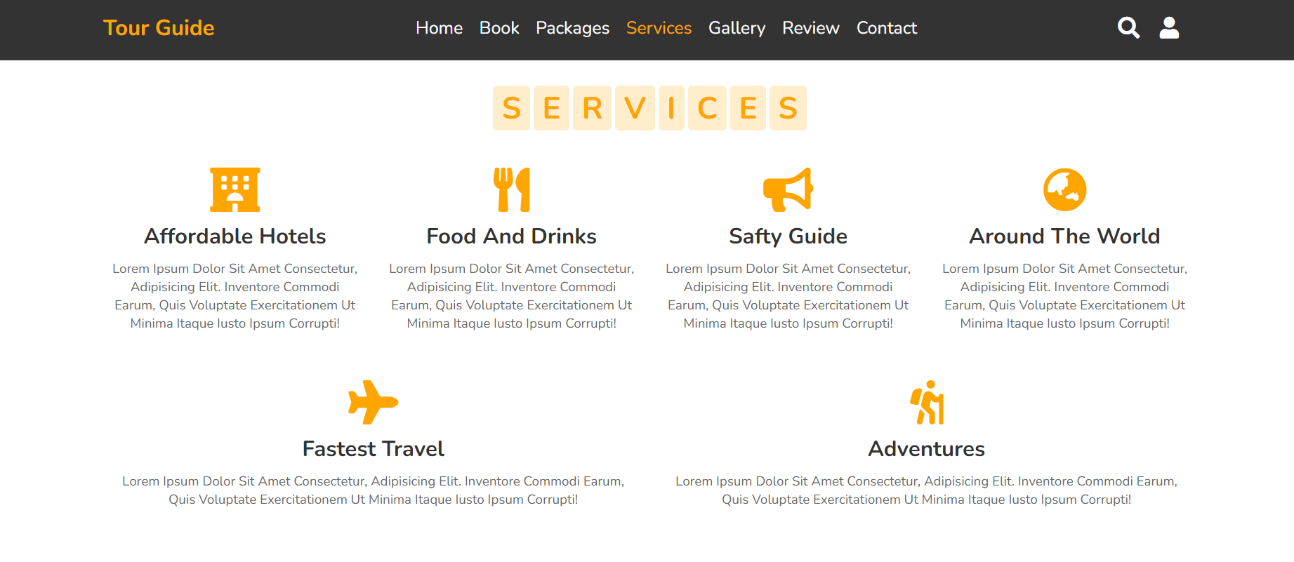
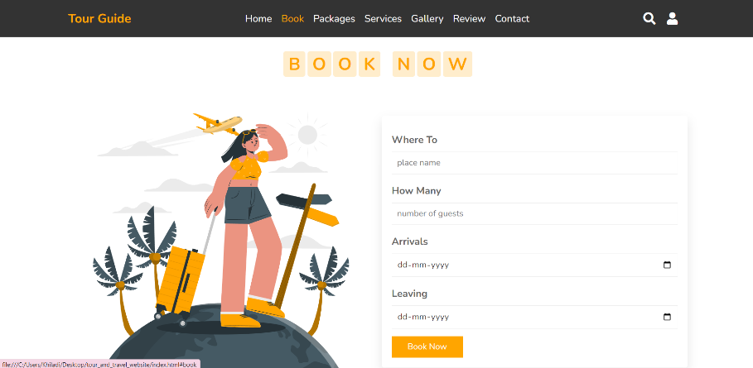
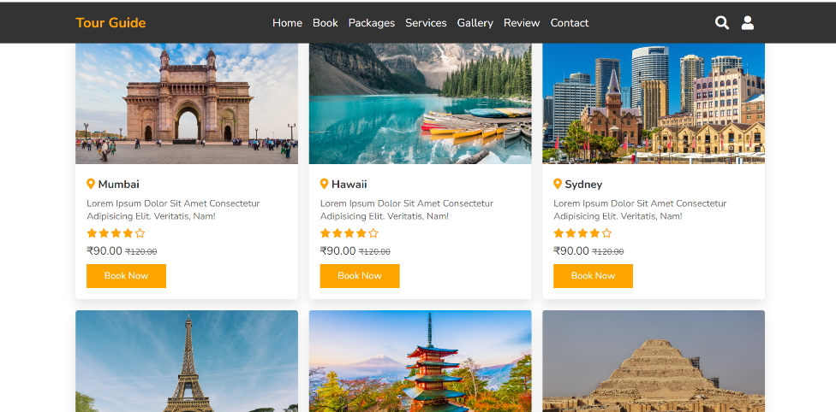
Tour India Application
Home Page
Services Page.
Signup Page:
Destinations:

Slide 15


